Slide 1
Chess Bot Using Minimax Algorithm
AIES Mini Project
^{Rohan Vayase PC-35}
^{Abhishek Singh PC-39}
^{Ujjval Kulkarni PC-38}
^{Navjot SIngh Sidhu PC-36}

Slide 2
Introduction
We have developed a chess bot using Minimax Algorithm. This program leverage artificial intelligence techniques and minimax algorithm to make intelligent decisions about chess moves, evaluate positions, and strategies against human or computer opponents.

Slide 3
Architecture
Our Chess Bot follows a modular architecture, consisting of distinct components for game logic, AI decision-making, and user interface. The minimax algorithm forms the core of the decision-making module, evaluating possible moves and selecting the optimal one base on a scoring mechanism.

Slide 4
MINIMAX Algorithm
The Minimax algorithm is a decision-making algorithm commonly used in two-player, turn-based games with perfect information, such as chess, checkers, tic-tac-toe and others.
The main objective of the Minimax algorithm is to determine the optimal move for a player, considering that the opponent will also make moves to minimize or maximize the outcome, depending on the perspective.

Slide 5
P5.js Library
The p5.js library provides a dynamic canvas for the chessboard and pieces, allowing for smooth user interface. Visual cues, such as highlighting legal moves and animating piece movements, enhance the user experience. The integration of p5.js in a Python environment is achieved through appropriate libraries and wrappers.

Slide 6
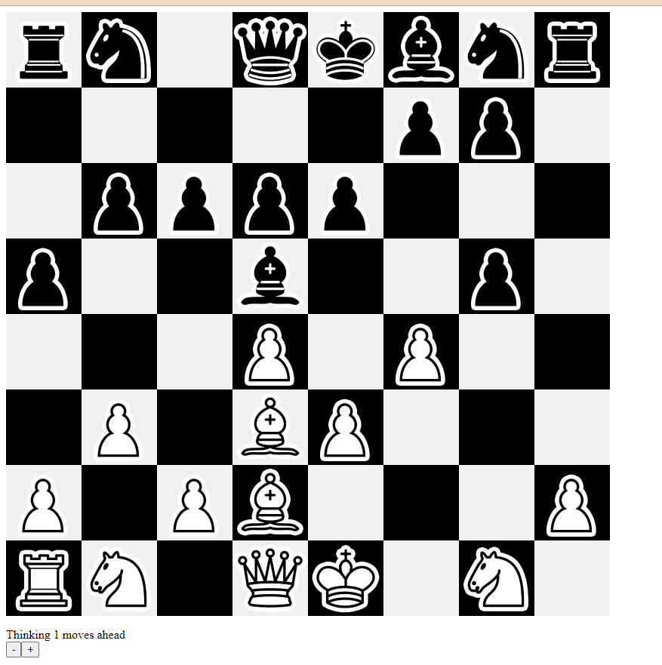
Output

Slide 7
Conclusion
In conclusion, our project successfully implemented a Chess Bot using the Minimax algorithm and the p5.js library in Python. The integration of intelligent decision-making with an interactive and visually appealing user interface provides a holistic gaming experience. Challenges encountered during the implementation process highlight the complexity of creating AI agents for strategic games. Future work may involve further optimization, exploring alternative visualization libraries, and incorporating additional AI techniques for enhanced gameplay.

Slide 8
Implementation
The Chess Bot is implementing in Python, utilizing the object-oriented paradigm to model game entities. Integration with the p5.js library facilitates real-time visualization, allowing users to interact with the chessboard and pieces. The Minimax algorithm, enhanced with alpha-beta pruning for efficiency, enables intelligent decision-making.

